Slide 1
Netflix Data Insights
Group 3: Aishwarya Sanjay Maloo, Arvind Murali, Hoang Duy Le, Prachi Rajendra Ashani

Slide 2
Table of Contents | S No.
Data Overview | 3
Project Objective | 5
Reviewing the Top 5s | 6
Are there any differences in the Top 5? | 10
Can we predict if a movie will receive top IMDb rating? | 13
R Shiny Demo | 15

Slide 3
Data Overview (1/2)
It is a subset of movies available on Netflix. With representation of many languages and genres, the dataset is diverse
Data source: Kaggle
Number of movies: Around 11k
Number of genres: 29
Number of languages available: 100+
Number of countries available: 36
Number of directors: Over 7k
Number of actors: Over 20k

Slide 4
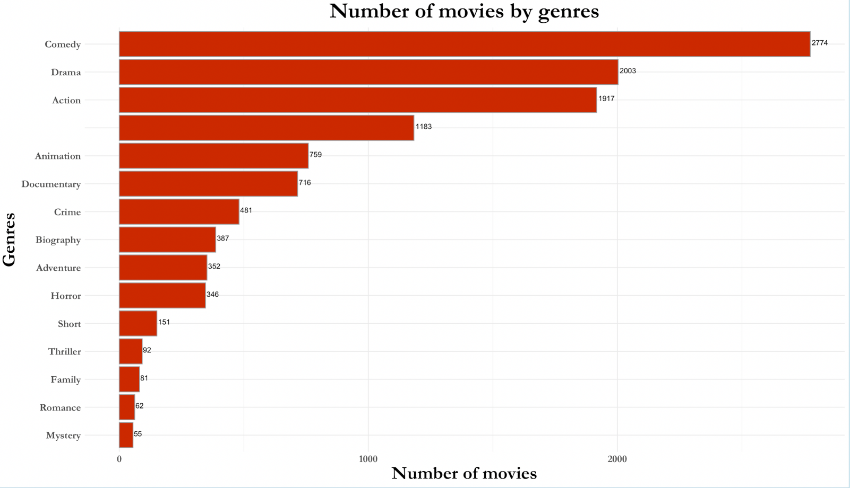
Data Overview (2/2)
Comedy, Drama, and Action movies primarily dominate the dataset
Notes:
genre_count_ = netflix_data[!is.na(netflix_data$title_director_actors) & !is.na(netflix_data$primary_g1) & !(netflix_data$primary_g1 %in% c('Talk-Show','Game-Show','Film-Noir')),c("primary_g1","title_director_actors")]
genre_count_ %>%
count(primary_g1, sort = TRUE) %>%
top_n(15,n) %>%
ggplot(aes(reorder(primary_g1,n),n)) +
geom_bar(stat="identity",fill = "#cc2900", color = '#999999')+
geom_text(aes(label = n), vjust=0.2, hjust=-0.1, color="black",
position = position_dodge(0.9), size=3.5)+
coord_flip()+
xlab("Genres") +
ylab("Number of movies")+
labs(title = 'Number of movies by genres')+
theme_minimal()+
theme(text = element_text(family = "Garamond", size = 25, face = "bold"))+
theme(axis.text.x = element_text(size=14, angle=0, face = "bold"))+
theme(axis.text.y = element_text(size=14, face = "bold"))+
theme(plot.title = element_text(hjust = 0.5, size = 30, face = "bold"))

Slide 5



Project Objective
Gain insights on the factors affecting the success of movies by reviewing –
IMDb ratings
Box office collection
Awards received

Slide 6
Exploratory Data Analysis Reviewing the Top 5s

Slide 7
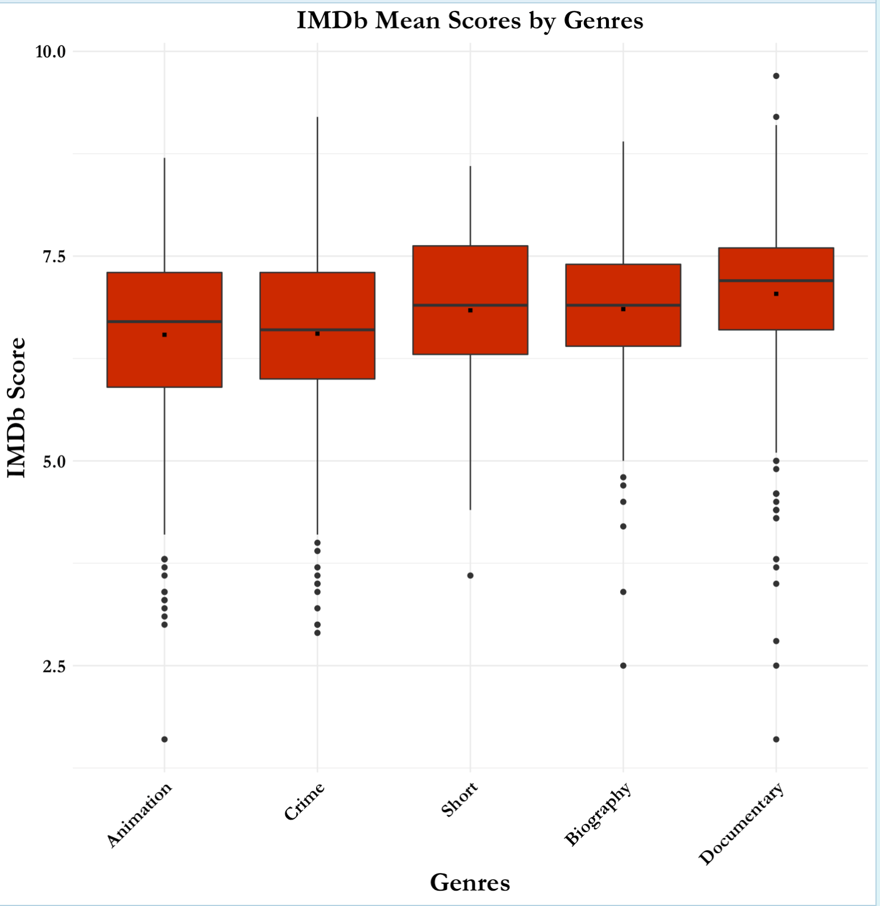
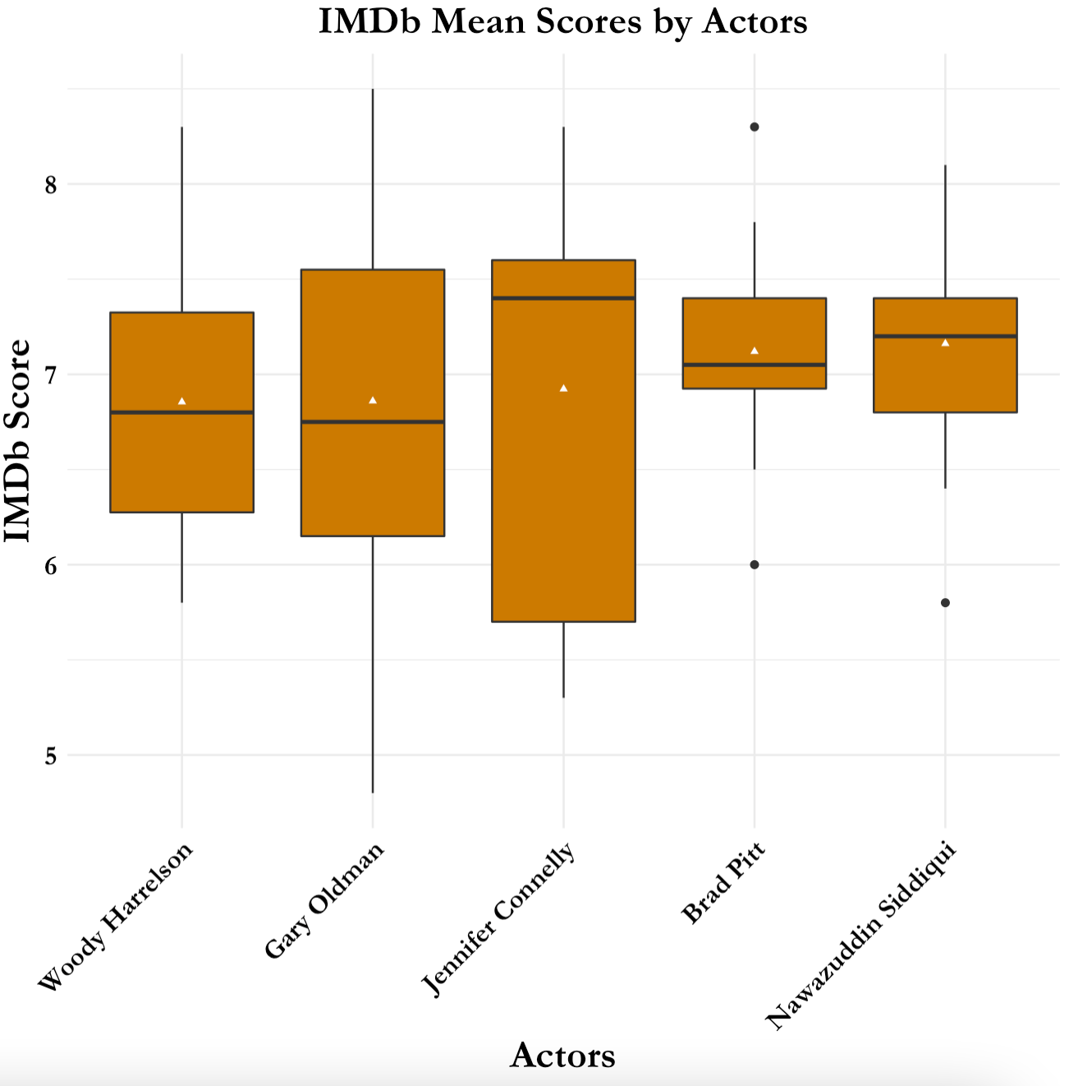
IMDb Chart Toppers
Documentaries such as No Festival and David Attenborough and Biographies such as Schindler’s List drove up the IMDb scores
Given the viewership breath of Hollywood movies, mostly American actors dominated the top 5 by mean
Notes:
netfilx1 = netflix_data[!is.na(netflix_data$imdb_score) & !is.na(netflix_data$primary_g1) & !(netflix_data$primary_g1 %in% c('Talk-Show','Game-Show','Film-Noir')),c("primary_g1","imdb_score")]
#genres having more than 20 movies
genre_count = netfilx1 %>%
count(primary_g1, sort = TRUE)
genre_count2 = genre_count[(genre_count$n >= 20),]
genre_count2
#genres to compare
genre_compare1=inner_join(netfilx1, genre_count2, by = c("primary_g1"="primary_g1"))
genre_compare1 %>%
group_by(primary_g1) %>%
summarise(mean_bo = mean(imdb_score, na.rm = TRUE)) %>%
arrange(-mean_bo) %>%
slice(1:5)
genre_compare1 = genre_compare1[genre_compare1$primary_g1 %in% c('Documentary','Biography', 'Short', 'Crime', 'Animation'),]
genre_compare1 = genre_compare1 %>%
mutate(highlight01 = ifelse(genre_compare1$primary_g1 %in% c('Documentary','Biography', 'Short', 'Crime', 'Animation'),"Yes","No"))
# genre_compare1 = genre_compare1 %>%
# mutate(highlight01 = ifelse(genre_compare1$primary_g1 %in% c('Adult', 'Music', 'Documentary', 'Biography', 'Short'),"Yes","No"))
genre_compare1 %>%
ggplot(aes(reorder(primary_g1,imdb_score),imdb_score,fill = highlight01))+
geom_boxplot() +
stat_summary(fun.y="mean", shape=15, size = 0.2)+
xlab("Genres") +
ylab("IMDb Score")+
scale_fill_manual(values = c("#cc2900"))+
theme_minimal()+
guides(fill = FALSE)+
theme(text = element_text(family = "Garamond", size = 14))+
theme(axis.text.x = element_text(colour = "black", size=14, face = "bold", angle=45, hjust =1))+
theme(axis.text.y = element_text(colour = "black", size=14, face = "bold"))+
theme(axis.title = element_text(size = 20, face = "bold"))+
labs(title = "IMDb Mean Scores by Genres")+
theme(plot.title = element_text(hjust = 0.5, size = 20, face = "bold"))
#Actors
Imdb_actors1 = netflix_data[!is.na(netflix_data$imdb_score) & !is.na(netflix_data$actors),c("actors","imdb_score")]
#actors having more than 10 movies
actors_count = Imdb_actors1 %>%
count(actors, sort = TRUE)
actors_count2 = actors_count[(actors_count$n >= 10),]
actors_count2
#actors having at least over 8 IMDb score one movie
actors_max_score = distinct(Imdb_actors1[(Imdb_actors1$imdb_score >= 8),], actors)
actors_max_score
#actors to compare
actors_compare1=inner_join(Imdb_actors1, actors_count2, by = c("actors"="actors"))
actors_compare2=inner_join(actors_compare1, actors_max_score, by = c("actors"="actors"))
actors_compare2 = actors_compare2[actors_compare2$actors %in% c('Jennifer Connelly','Nawazuddin Siddiqui', 'David Strathairn', 'Brad Pitt', 'Morgan Freeman'),]
actors_compare2 = actors_compare2 %>%
mutate(highlight01 = ifelse(actors_compare2$actors %in% c('Jennifer Connelly','Nawazuddin Siddiqui', 'David Strathairn', 'Brad Pitt', 'Morgan Freeman'),"Yes","No"))
actors_compare2 %>%
ggplot(aes(reorder(actors,imdb_score), imdb_score,fill = highlight01))+
geom_boxplot() +
stat_summary(fun.y="mean", shape=17, size = 0.2)+
xlab("Actors") +
ylab("IMDb Score") +
scale_fill_manual(values = "#cc7a00")+
theme_minimal()+
guides(fill = "none")+
theme(text = element_text(family = "Garamond", size = 14))+
theme(axis.text.x = element_text(colour = "black", size=14, face = "bold", angle=45, hjust =1))+
theme(axis.text.y = element_text(colour = "black", size=14, face = "bold"))+
theme(axis.title = element_text(size = 20, face = "bold"))+
labs(title = "IMDb Mean Scores by Actors")+
theme(plot.title = element_text(hjust = 0.5, size = 20, face = "bold"))

Slide 8
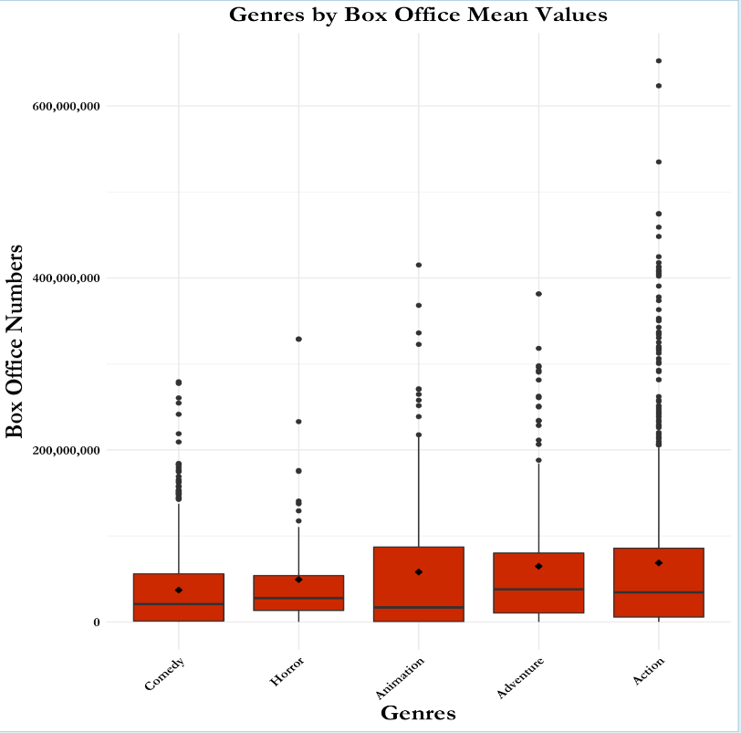
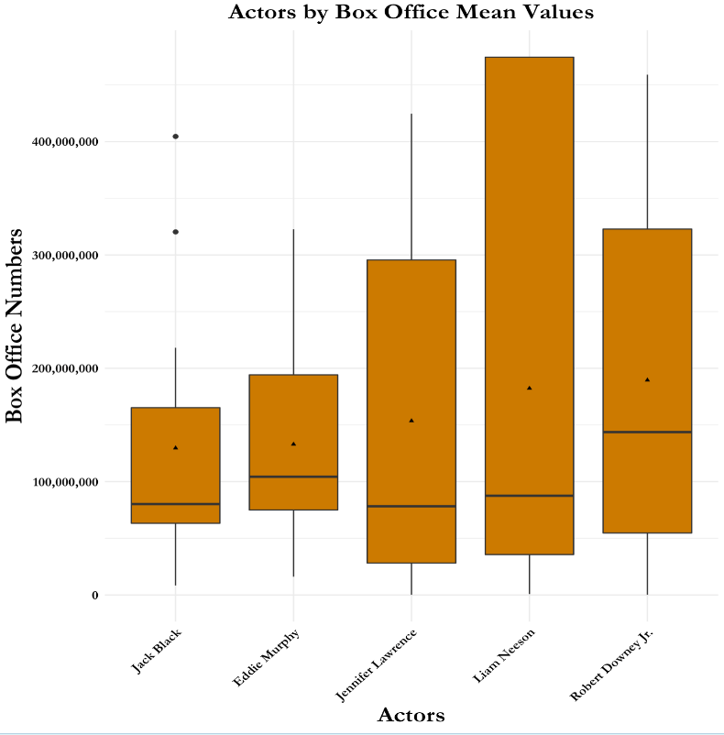
Box Office Chart Toppers
Marvel and DC movies, and Jurassic World were significant Box Office value drivers for Action
Owing to Iron Man’s and Avenger’s popularity, RDJ topped the Box Office Chart
Notes:
#Genres R-code with Genres
netfilx1 = netflix_data[!is.na(netflix_data$boxoffice) & !is.na(netflix_data$primary_g1) & !(netflix_data$primary_g1 %in% c('Talk-Show','Game-Show','Film-Noir')),c("primary_g1","boxoffice")]
#genres having more than 10 movies
genre_count = netfilx1 %>%
count(primary_g1, sort = TRUE)
genre_count2 = genre_count[(genre_count$n >= 20),]
genre_compare1 = inner_join(netfilx1, genre_count2, by = c("primary_g1"="primary_g1"))
genre_compare1
genre_compare1 %>%
group_by(primary_g1) %>%
summarise(mean_bo = mean(boxoffice, na.rm = TRUE)) %>%
arrange(-mean_bo) %>%
slice(1:5)
genre_compare1 = genre_compare1[genre_compare1$primary_g1 %in% c('Action','Adventure', 'Animation', 'Horror', 'Comedy'),]
genre_compare1 = genre_compare1 %>%
mutate(highlight01 = ifelse(genre_compare1$primary_g1 %in% c('Action','Adventure', 'Animation', 'Horror', 'Comedy'),"Yes","No"))
genre_compare1 %>%
ggplot(aes(reorder(primary_g1,boxoffice),boxoffice,fill = highlight01))+
geom_boxplot() +
stat_summary(fun.y="mean", shape=9, size = 0.2)+
xlab("Genres") +
scale_y_continuous(name="Box Office Numbers", labels = comma)+
scale_fill_manual(values = c("#cc2900"))+
theme_minimal()+
guides(fill = FALSE)+
theme(text = element_text(family = "Garamond", size = 14))+
theme(axis.text.x = element_text(colour = "black", face = "bold", angle=45, hjust =1, size=14))+
theme(axis.text.y = element_text(colour = "black", face = "bold", size=14))+
theme(axis.title = element_text(size = 20, face = "bold"))+
labs(title = "Genres by Box Office Mean Values")+
theme(plot.title = element_text(hjust = 0.5, size = 20, face = "bold"))
#Actors R-code with Boxoffice
Imdb_actors1 = netflix_data[!is.na(netflix_data$boxoffice) & !is.na(netflix_data$actors),c("actors","boxoffice")]
#actors having more than 10 movies
actors_count = Imdb_actors1 %>%
count(actors, sort = TRUE)
actors_count2 = actors_count[(actors_count$n >= 10),]
actors_count2
actor_compare1 = inner_join(Imdb_actors1, actors_count2, by = c("actors"="actors"))
actor_compare1
actor_compare1 %>%
group_by(actors) %>%
summarise(mean_bo = mean(boxoffice, na.rm = TRUE)) %>%
arrange(-mean_bo) %>%
slice(1:5)
actor_compare1 = actor_compare1[actor_compare1$actors %in% c('Robert Downey Jr.','Liam Neeson', 'Jennifer Lawrence', 'Eddie Murphy', 'Jack Black'),]
actor_compare1 = actor_compare1 %>%
mutate(highlight01 = ifelse(actor_compare1$actors %in% c('Robert Downey Jr.','Liam Neeson', 'Jennifer Lawrence', 'Eddie Murphy', 'Jack Black'),"Yes","No"))
actor_compare1 %>%
ggplot(aes(reorder(actors,boxoffice), boxoffice,fill = highlight01))+
geom_boxplot() +
stat_summary(fun.y="mean", shape=17, size = 0.2)+
xlab("Actors") +
scale_y_continuous(name="Box Office Numbers", labels = comma) +
scale_fill_manual(values = "#cc7a00")+
theme_minimal()+
guides(fill = "none")+
theme(text = element_text(family = "Garamond", size = 14))+
theme(axis.text.x = element_text(colour = "black", size=14, face = "bold", angle=45, hjust =1))+
theme(axis.text.y = element_text(colour = "black", size=14, face = "bold"))+
theme(axis.title = element_text(size = 20, face = "bold"))+
labs(title = "Actors by Box Office Mean Values")+
theme(plot.title = element_text(hjust = 0.5, size = 20, face = "bold"))

Slide 9
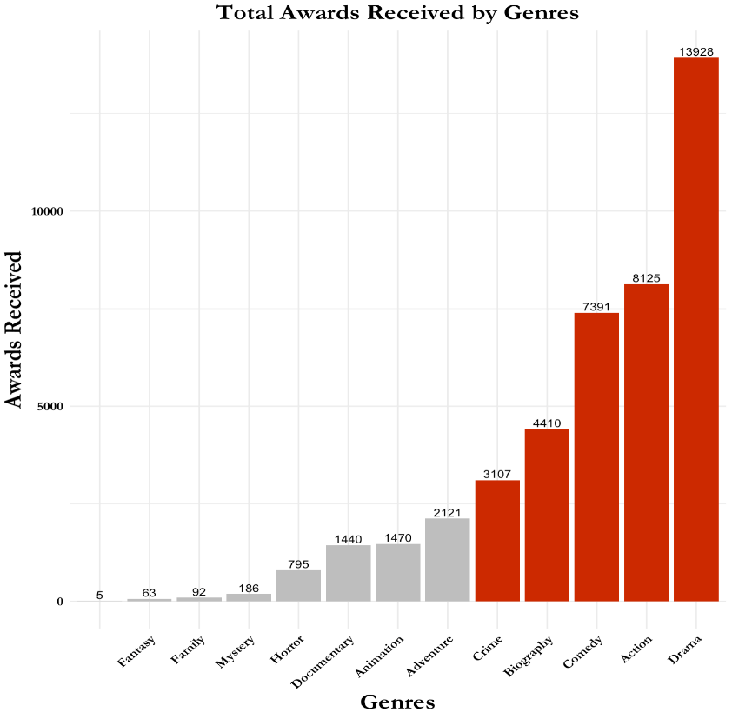
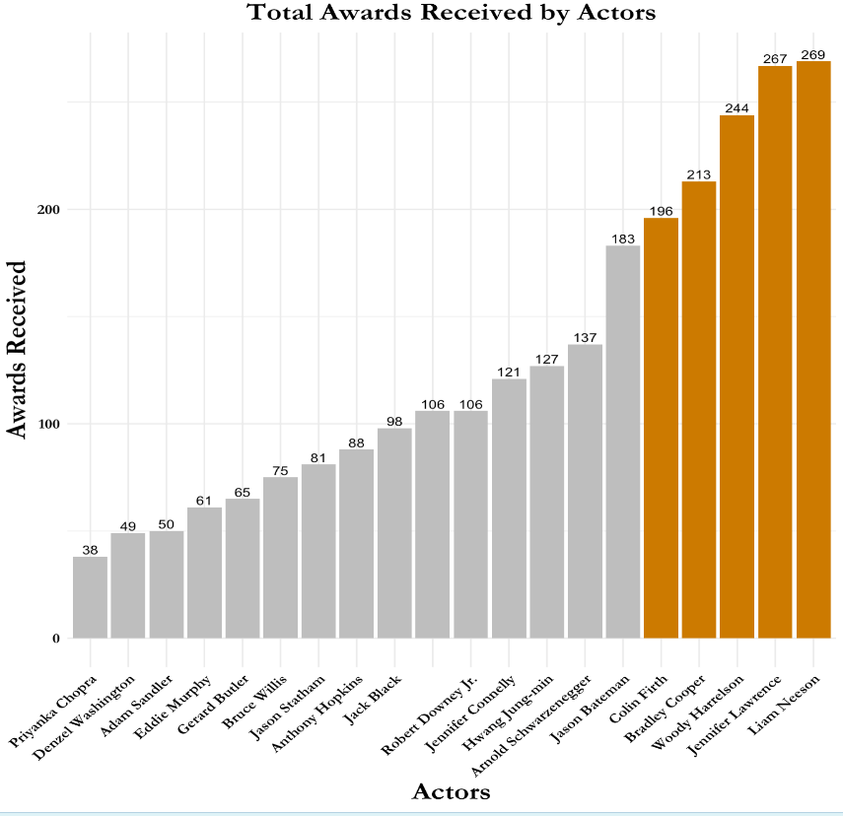
Top Award Grabbers
Movies such as Parasite, Roma, Gravity were significant contributors to award wins for Drama
90s action movies contributed to Neeson’s award count while Silver Lining Playbook and The Hunger Games contributed to Lawrence’s
Notes:
#ACTORS AND AWARDS RECEIVED
awards_received_actors1 = netflix_data[!is.na(netflix_data$awards_received) & !is.na(netflix_data$actors),c("actors","awards_received")]
#actors having more than 10 movies
actors_count = awards_received_actors1 %>%
count(actors, sort = TRUE)
actors_count2 = actors_count[(actors_count$n >= 10),]
#actors having at least over 10 awards one movie
actors_max_score = distinct(awards_received_actors1[(awards_received_actors1$awards_received >= 10),], actors)
#actors to compare
actors_compare1=inner_join(awards_received_actors1, actors_count2, by = c("actors"="actors"))
actors_compare2=inner_join(actors_compare1, actors_max_score, by = c("actors"="actors"))
actors_compare3 = actors_compare2 %>%
group_by(actors) %>%
summarise(sum_awards = sum(awards_received))
actors_compare3 = actors_compare3 %>%
mutate(highlight01 = ifelse(actors_compare3$actors %in% c('Jennifer Lawrence', 'Liam Neeson', 'Woody Harrelson', 'Bradley Cooper', 'Colin Firth'),"Yes","No"))
actors_compare3 %>%
ggplot(aes(reorder(actors,sum_awards),sum_awards,fill = highlight01)) +
geom_bar(stat="identity") +
geom_text(aes(label=sum_awards), vjust=-0.3, color="black",
position = position_dodge(0.9), size=3.5)+
xlab("Actors") +
ylab("Awards Received")+
scale_fill_manual(values = c("grey","#cc7a00"))+
guides(fill = "none")+
theme_minimal()+
theme(text = element_text(family = "Garamond", size = 14))+
theme(axis.text.x = element_text(colour = "black", size=14, face = "bold", angle=45, hjust =1))+
theme(axis.text.y = element_text(colour = "black", size=14, face = "bold"))+
theme(axis.title = element_text(size = 20, face = "bold"))+
labs(title = "Total Awards Received by Actors")+
theme(plot.title = element_text(hjust = 0.5, size = 20, face = "bold"))
theme(axis.text.x=element_text(size=10, angle=45,hjust = 1))
#GENRES AND AWARDS RECEIVED
netfilx1 = netflix_data[!is.na(netflix_data$awards_received) & !is.na(netflix_data$primary_g1) & !(netflix_data$primary_g1 %in% c('Talk-Show','Game-Show','Film-Noir')),c("primary_g1","awards_received")]
netflix1 = netfilx1 %>%
mutate(highlight01 = ifelse(netfilx1$primary_g1 %in% c('Biography', 'History', 'Drama', 'Crime', 'Adventure'),"Yes","No"))
netflix2 = netflix1%>%
group_by(primary_g1) %>%
summarise(sum_awards = sum(awards_received))
netflix2 = netflix2 %>%
mutate(highlight01 = ifelse(netflix2$primary_g1 %in% c('Drama','Biography', 'Comedy', 'Action', 'Crime'),"Yes","No"))
netflix2[!(netflix2$primary_g1 %in% c('Music','War','Western','Sci-Fi','Romance','Musical','Short','History','Thriller')),] %>%
ggplot(aes(reorder(primary_g1,sum_awards),sum_awards,fill = highlight01)) +
geom_bar(stat="identity") +
geom_text(aes(label=sum_awards), vjust=-0.3, color="black",
position = position_dodge(0.9), size=3.5)+
xlab("Genres") +
ylab("Awards Received")+
scale_fill_manual(values = c("grey","#cc2900"))+
guides(fill = "none")+
theme_minimal()+
guides(fill = "none")+
theme(text = element_text(family = "Garamond", size = 14))+
theme(axis.text.x = element_text(colour = "black", size=14, face = "bold", angle=45, hjust =1))+
theme(axis.text.y = element_text(colour = "black", size=14, face = "bold"))+
theme(axis.title = element_text(size = 20, face = "bold"))+
labs(title = "Total Awards Received by Genres")+
theme(plot.title = element_text(hjust = 0.5, size = 20, face = "bold"))
theme(axis.text.x=element_text(size=10, angle=45,hjust = 1))

Slide 10
Analysis of Variance Are there any differences in the Top 5?

Slide 11
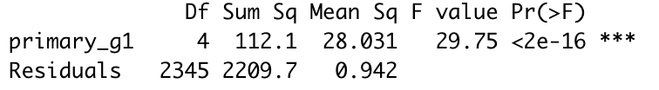
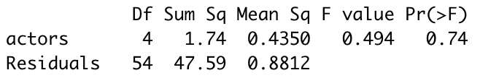
IMDb Chart Toppers
ANOVA for Top 5 Genres by IMDb Mean Score
H₀: There is no difference in the mean IMDb score of top 5 genres
H₁: There is at least one genre out 5 that has a different mean IMDb score
ANOVA for Top 5 Actors by IMDb Mean Score
H₀: There is no difference in the mean IMDb score of top 5 actors
H₁: There is at least one of 5 actor that has a different mean IMDb score
Since the p-value < 0.05, we reject the null hypothesis and conclude that there is a difference in IMDb score across top highest-score genres.
Tukey’s HSD helps indicate the difference in the mean of –
Biography – Animation
Documentary – Animation
Crime – Biography
Documentary – Crime
Since the p-value > 0.05. we fail to reject the null hypothesis and conclude that there is NO difference in the mean IMDb score of top 5 actors.

Slide 12
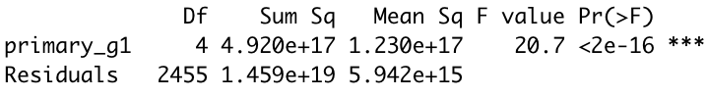

Box Office Chart Toppers
ANOVA for Top 5 Genres by Mean BO Value
H₀: There is no difference in the mean BO value of top 5 genres
H₁: There is at least one genre out of 5 that has a different mean BO value
ANOVA for Top 5 Actors by mean BO value
H₀: There is no difference in the mean BO value of top 5 actors
H₁: There is at least one of 5 actor that has a different mean BO value
Since the p-value < 0.05, we reject the null hypothesis and conclude that there is a difference in mean BO value of top 5 genres
Tukey’s HSD helps indicate the difference in the mean of –
Comedy – Action
Comedy – Adventure
Comedy – Animation
Since the p-value > 0.05. we fail to reject the null hypothesis and conclude that there is NO difference in the mean Box Office value of top 5 actors.
Notes:
boxoffice_actor_high.aov <- aov(boxoffice ~ actors, data = actor_compare1[actor_compare1$actors %in% c('Eddie Murphy', 'Robert Downey Jr.', 'Liam Neeson', 'Jennifer Lawrence', 'Jack Black'),])
summary(boxoffice_actor_high.aov)
TukeyHSD(boxoffice_actor_high.aov)
boxoffice_genre_high.aov <- aov(boxoffice ~ primary_g1, data = genre_compare1[genre_compare1$primary_g1 %in% c('Action', 'Adventure', 'Animation', 'Horror', 'Comedy'),])
summary(boxoffice_genre_high.aov)
TukeyHSD(boxoffice_genre_high.aov)

Slide 13
Regression Analysis Can we predict if a movie will receive top IMDb rating?

Slide 14
IMDb Score Prediction
Runtime over 2 hours, number of languages a movie is available in, and Rotten Tomato reviews have a significant influence on the IMDb score for a movie.
Overall p-value: 0.000
Overall F-statistic: 629.7
Multiple R^2: 0.6046
Adjusted R^2: 0.6036
All predictors are significant
Linear equation:
IMDb Score = 4.46 + 0.27 Runtime over 2 hrs + 0.033 Language Count +
0.026 Rotten Tomato Score + 0.032 log(Box Office) + 0.0044 Awards Received – 0.03 Genre Count

Slide 15
R Shiny Demo

Slide 16
And that’s a wrap!

